Slide 1
Neural & Adaptive Systems
Final Project – Part B
Aadarsh Vadakattu (UMKC ID 16251483)

Slide 2
Implemented Logic
After extracting the best functioning features from Part A of the project (Both training and Testing), I created target value matrix using a simple loop for both training and testing, and later on used it to train all neural networks(used patternnet). Refer “target 1s and 0s” division in “code.m” file in the uploaded zip to find out the loop.
I tried to implement a simple loop which automatically trains all networks on its own and puts out all training and testing ROCs at once, but I was not able to save the networks using that loop. Refer to code “Network 1” for this part.(kept entirely in comments)
So I manually changed values for each subject training of network every time and plotted training and testing ROCs. Refer to block “Network 2” for this part.
I saved all trained networks in the “Outputs/Networks” directory in the zip file. All the subjects’ ROCs are as shown below:

Slide 3
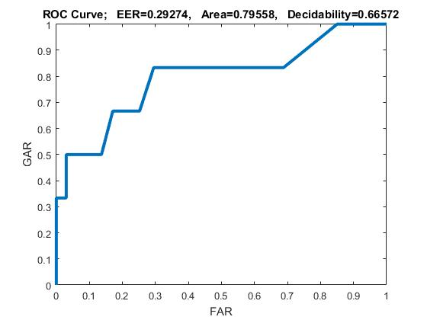
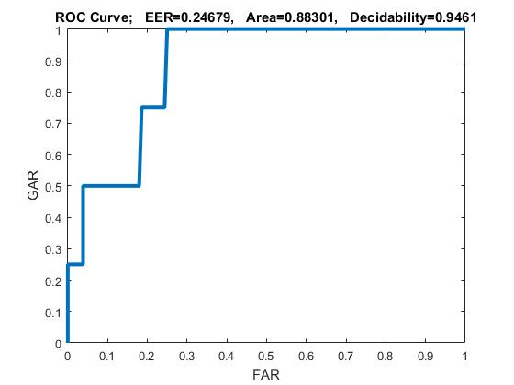
Subject 1
Training ROC
Testing ROC

Slide 4
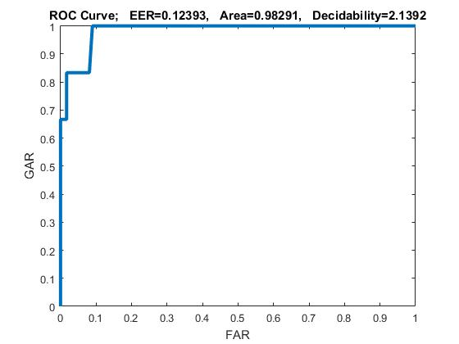
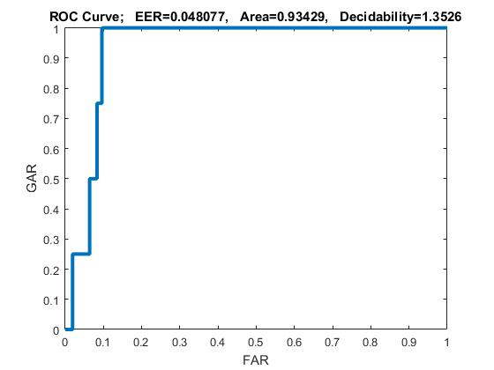
Subject 2
Training ROC
Testing ROC

Slide 5
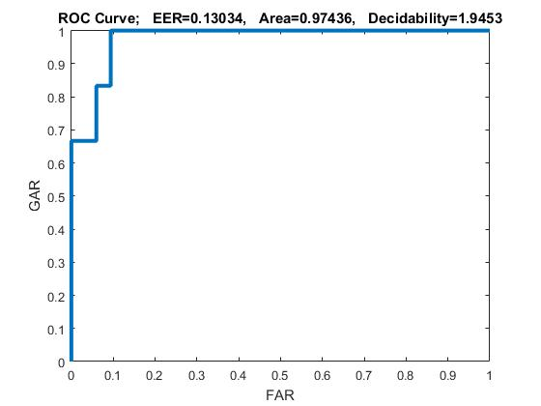
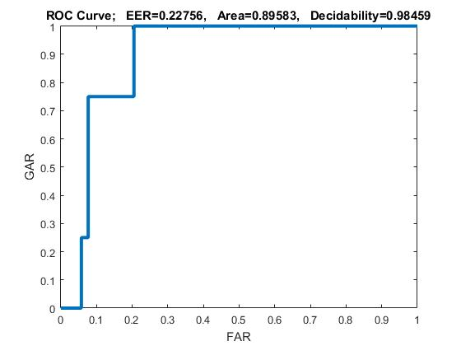
Subject 3
Training ROC
Testing ROC

Slide 6
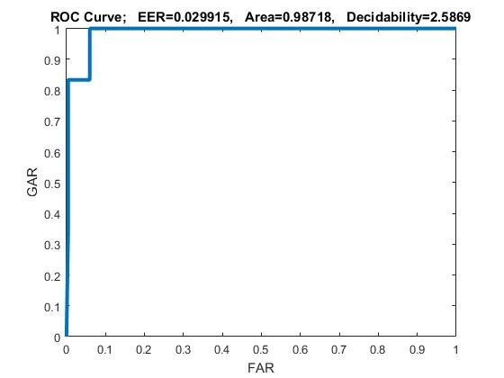
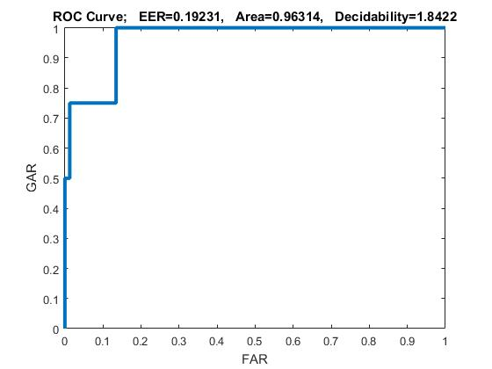
Subject 4
Training ROC
Testing ROC

Slide 7
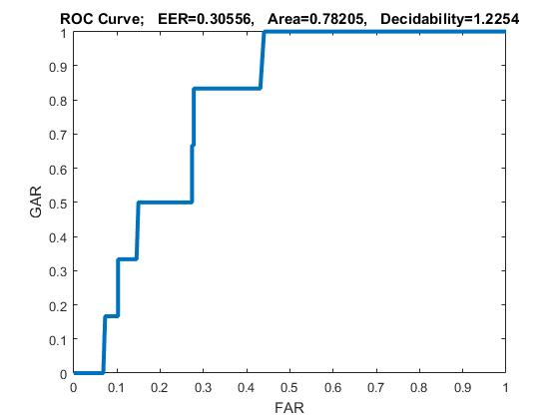
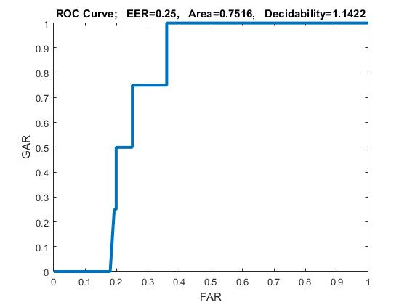
Subject 5
Training ROC
Testing ROC

Slide 8
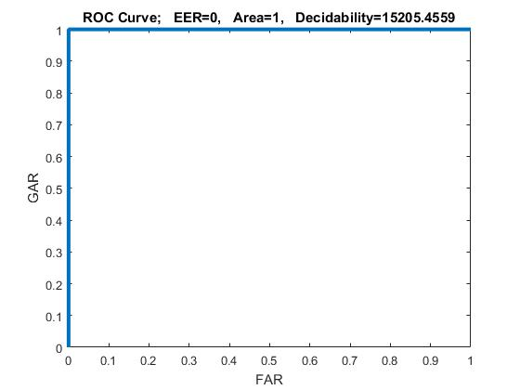
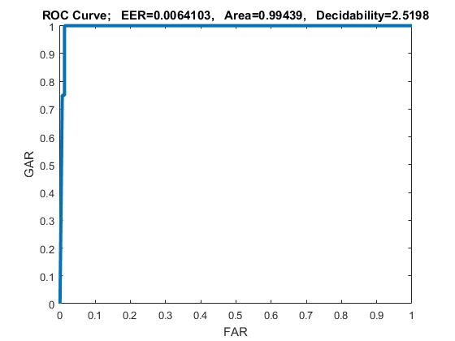
Subject 6
Training ROC
Testing ROC

Slide 9
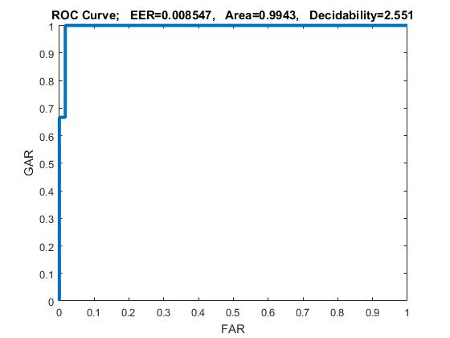
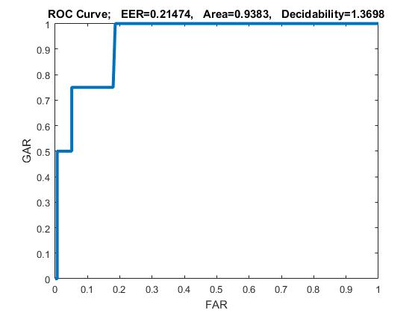
Subject 7
Training ROC
Testing ROC

Slide 10
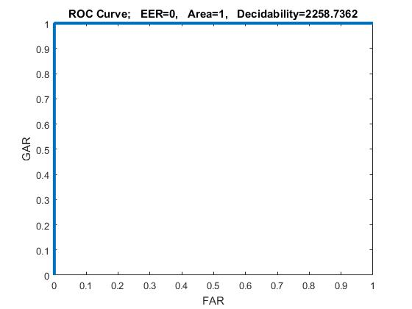
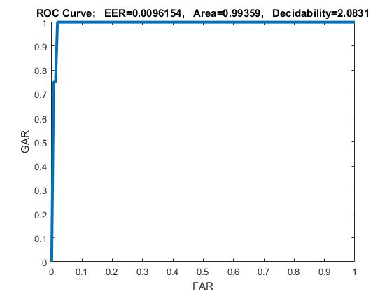
Subject 8
Training ROC
Testing ROC

Slide 11
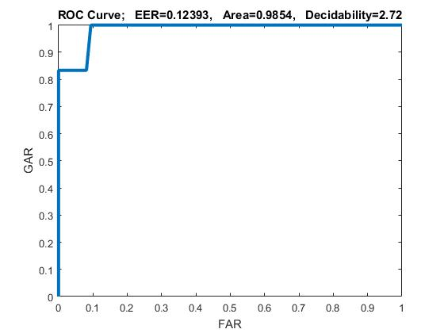
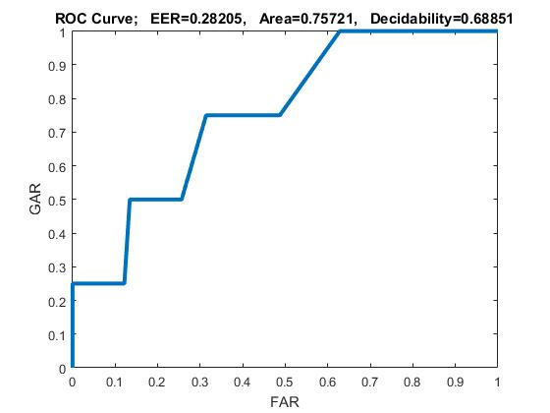
Subject 9
Training ROC
Testing ROC

Slide 12
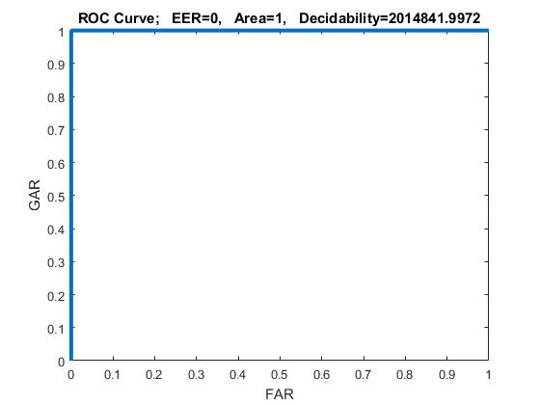
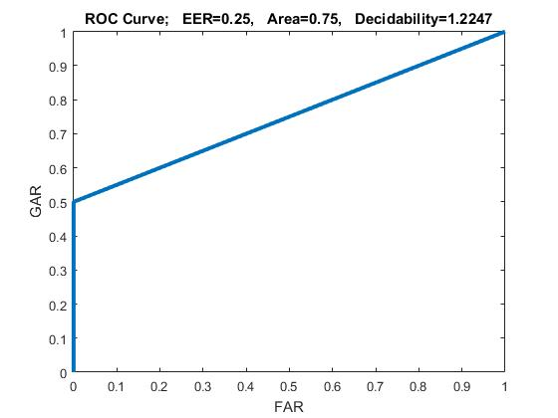
Subject 10
Training ROC
Testing ROC

Slide 13
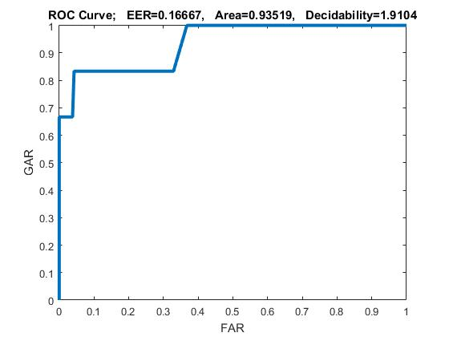
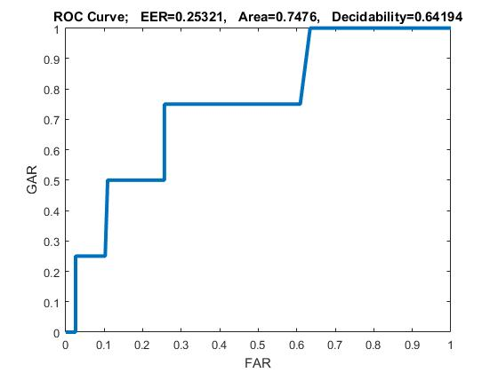
Subject 11
Training ROC
Testing ROC

Slide 14
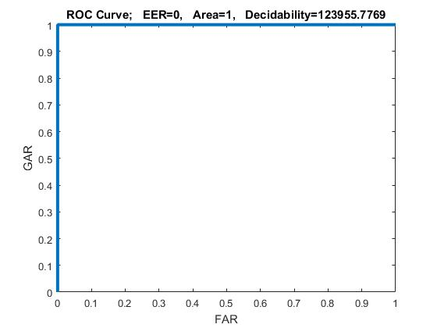
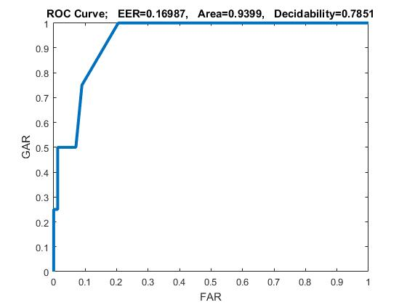
Subject 12
Training ROC
Testing ROC

Slide 15
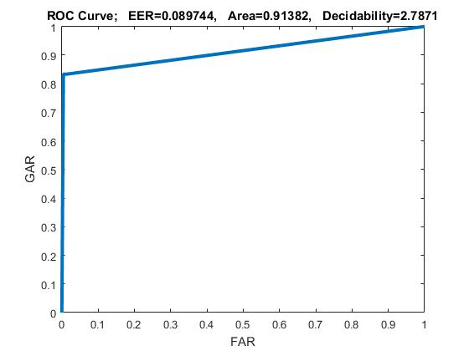
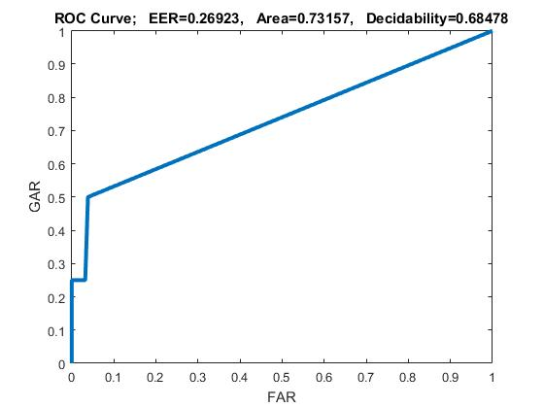
Subject 13
Training ROC
Testing ROC

Slide 16
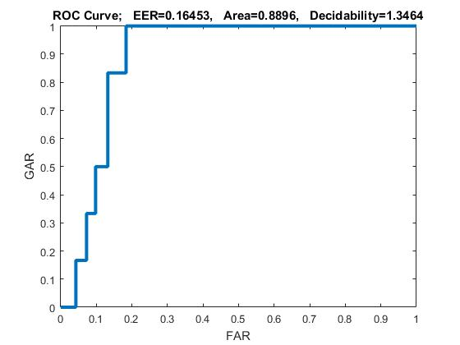
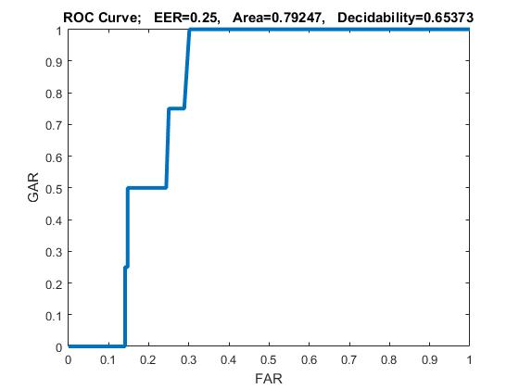
Subject 14
Training ROC
Testing ROC

Slide 17
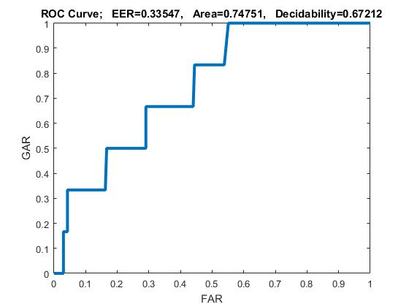
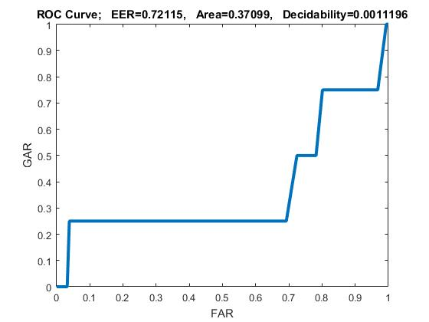
Subject 15
Training ROC
Testing ROC

Slide 18
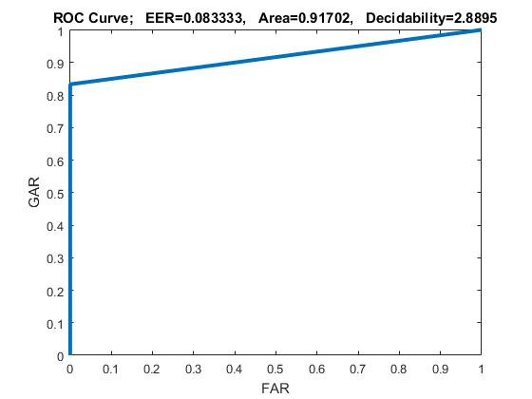
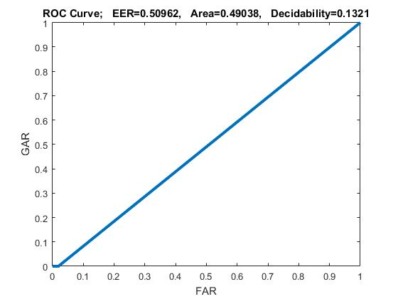
Subject 16
Training ROC
Testing ROC

Slide 19
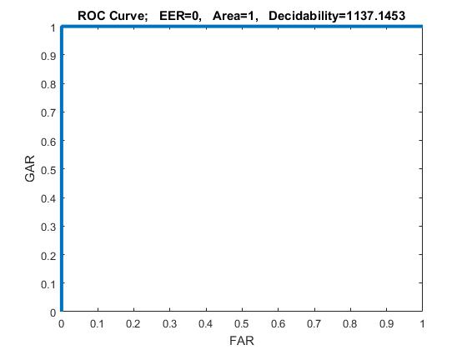

Subject 17
Training ROC
Testing ROC

Slide 20
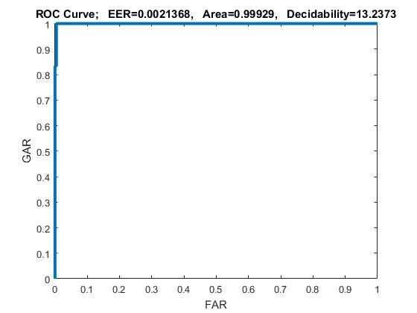
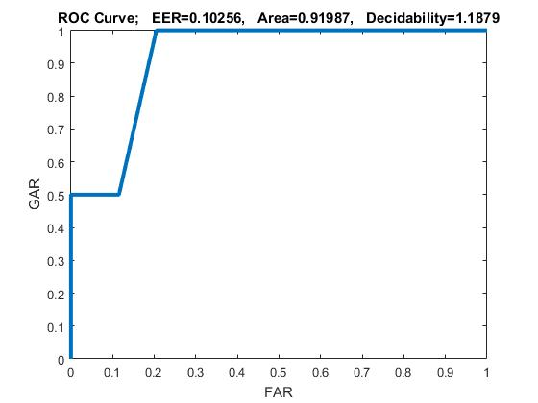
Subject 18
Training ROC
Testing ROC

Slide 21
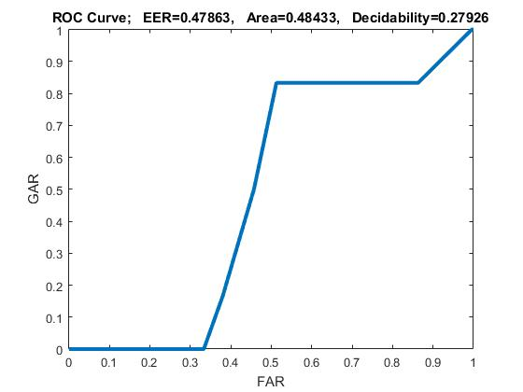
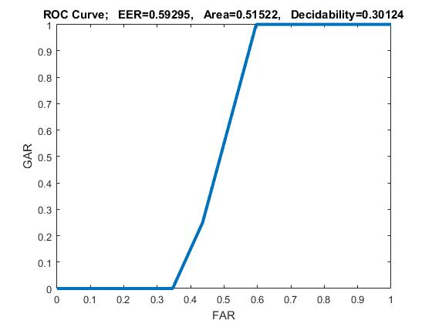
Subject 19
Training ROC
Testing ROC

Slide 22
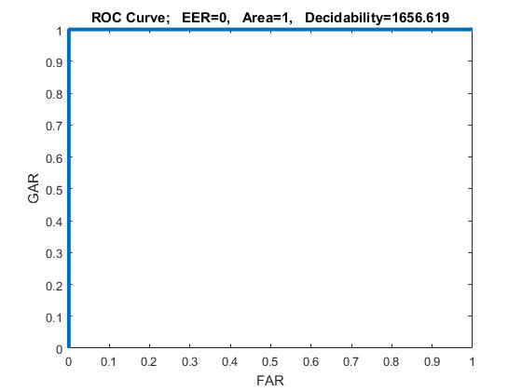
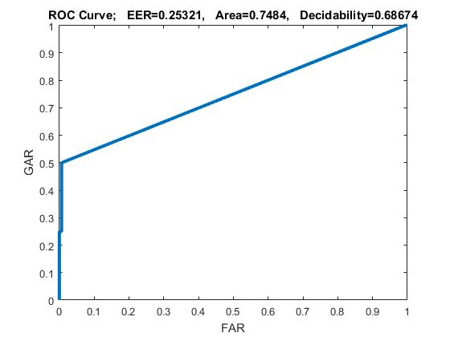
Subject 20
Training ROC
Testing ROC

Slide 23

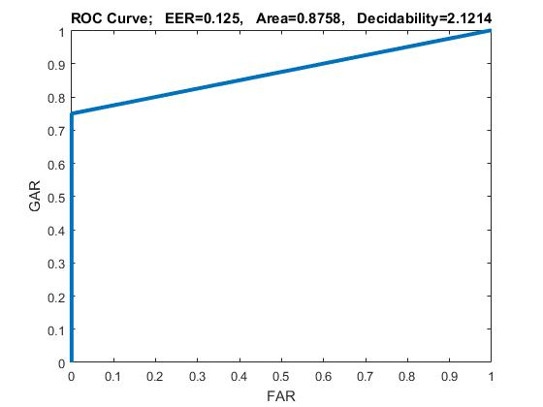
Subject 21
Training ROC
Testing ROC

Slide 24


Subject 22
Training ROC
Testing ROC

Slide 25

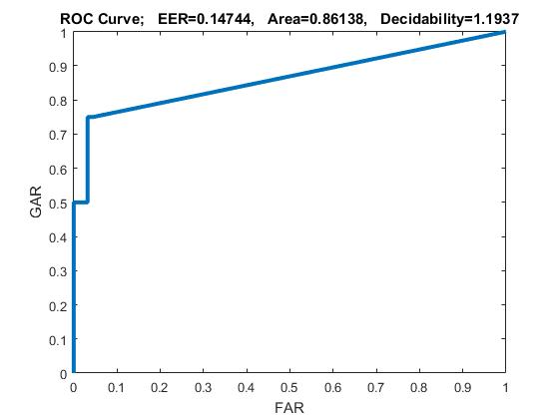
Subject 23
Training ROC
Testing ROC

Slide 26
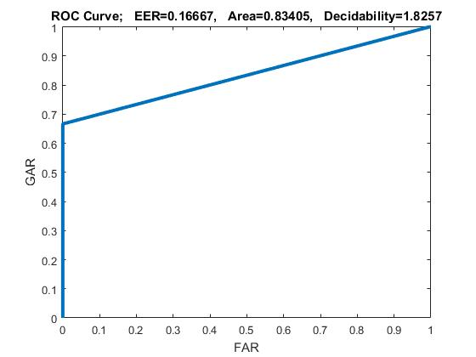
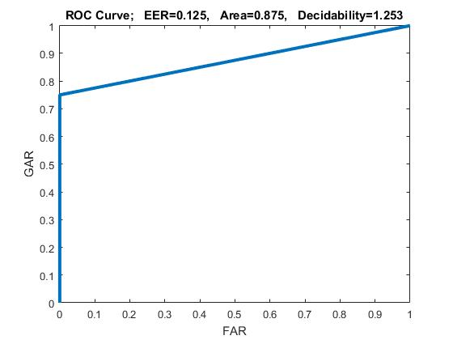
Subject 24
Training ROC
Testing ROC

Slide 27
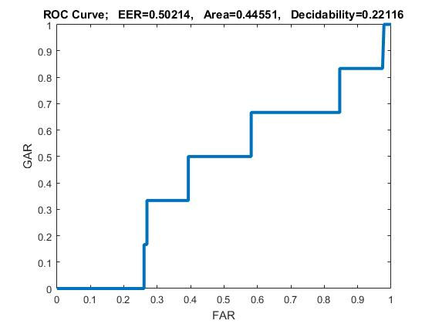
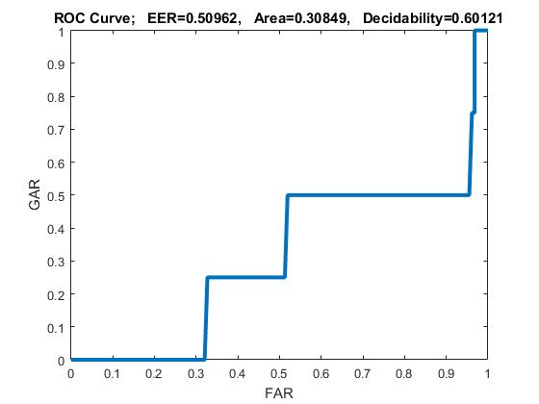
Subject 25
Training ROC
Testing ROC

Slide 28
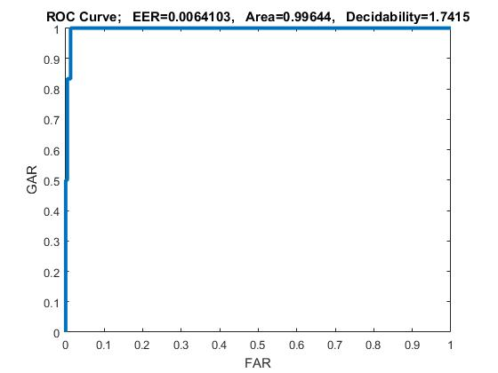
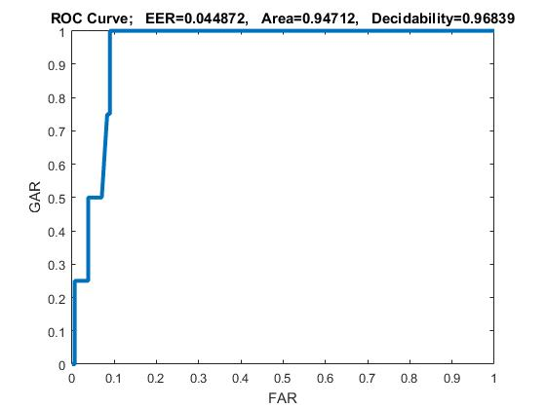
Subject 26
Training ROC
Testing ROC

Slide 29

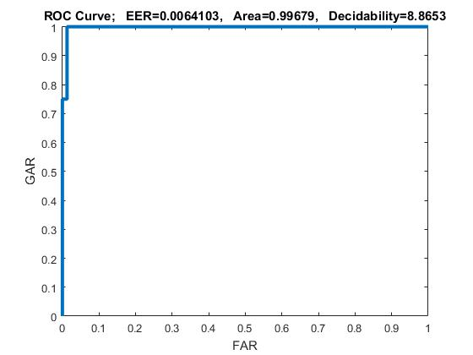
Subject 27
Training ROC
Testing ROC

Slide 30
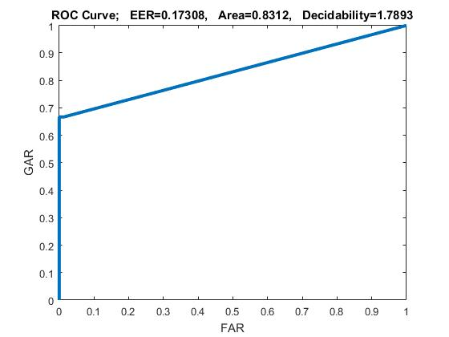
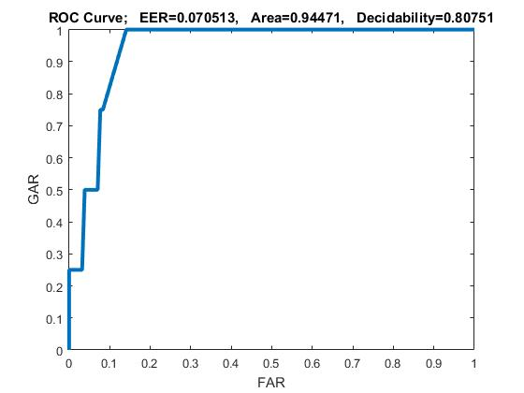
Subject 28
Training ROC
Testing ROC

Slide 31


Subject 29
Training ROC
Testing ROC

Slide 32


Subject 30
Training ROC
Testing ROC

Slide 33


Subject 31
Training ROC
Testing ROC

Slide 34


Subject 32
Training ROC
Testing ROC

Slide 35


Subject 33
Training ROC
Testing ROC

Slide 36


Subject 34
Training ROC
Testing ROC

Slide 37


Subject 35
Training ROC
Testing ROC

Slide 38

Subject 36
Training ROC
Testing ROC

Slide 39


Subject 37
Training ROC
Testing ROC

Slide 40


Subject 38
Training ROC
Testing ROC

Slide 41


Subject 39
Training ROC
Testing ROC

Slide 42


Subject 40
Training ROC
Testing ROC

